Slide 1
Data set support II
The SUPPORT (Study to Understand Prognoses and Preferences for Outcomes and Risks of Treatments) dataset is an extensive collection of data from critically ill patients. It encompasses records from 9105 patients across five medical centers in the United States, covering two study periods: 1989-1991 and 1992-1994. This dataset is unique in its focus on nine critical disease categories, including acute respiratory failure, various cancers, and multiple organ system failures.
https://archive.ics.uci.edu/dataset/880/support2

Slide 2
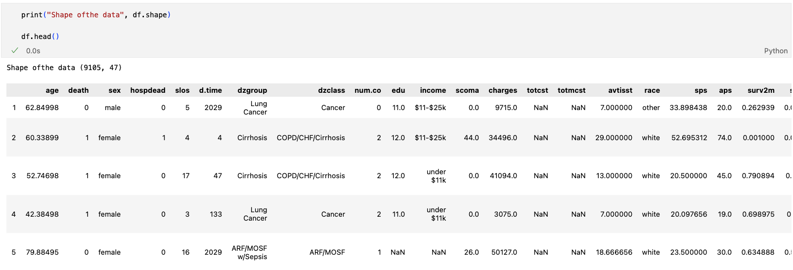
Data Set structure

Slide 3

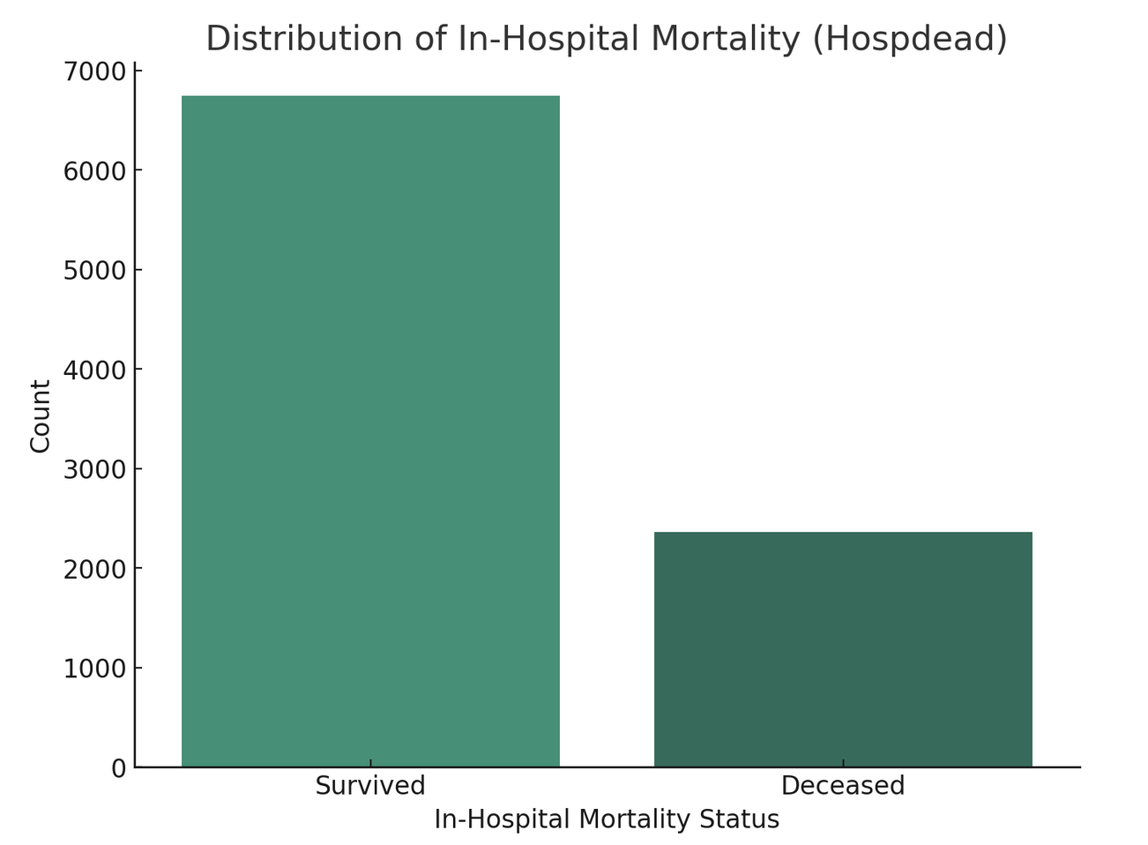
Predicting In-Hospital Mortality - A Binary Classification Challenge
The primary objective of our classification analysis is to predict in-hospital mortality, a critical outcome in healthcare settings. This binary classification problem focuses on determining whether a critically ill patient will survive (0) or succumb during their hospital stay (1).

Slide 4
Importance
The ability to predict mortality can significantly aid in clinical decision-making, resource allocation, and patient-family counseling, particularly in managing end-of-life care scenarios.

Slide 5

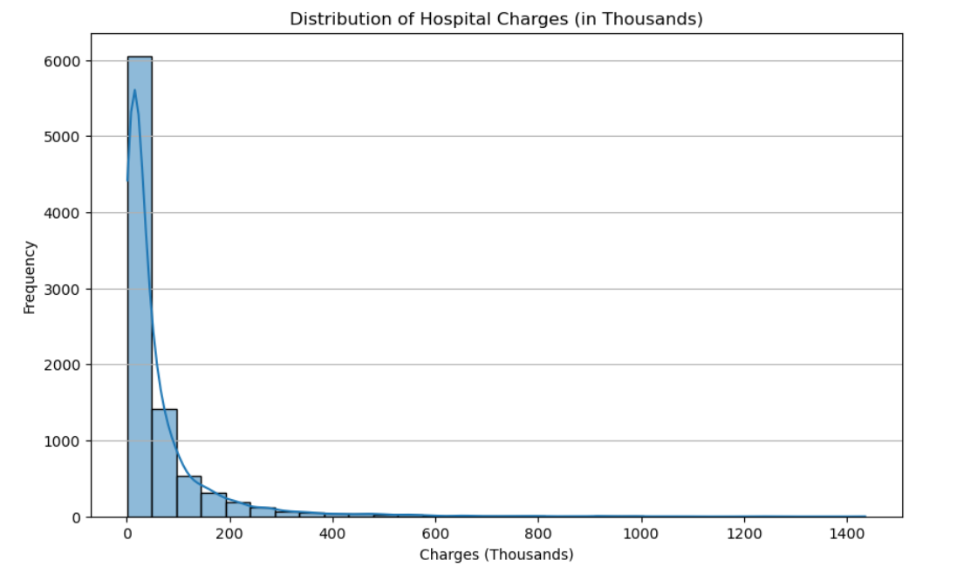
Forecasting Total Hospital Costs - A Regression Task
The regression aspect of our analysis aims to predict the total hospital costs incurred per patient. This is a continuous variable prediction, requiring the model to estimate the monetary cost associated with a patient's hospital stay. The challenge lies in correlating various factors like treatment procedures, length of stay, severity of illness, and patient demographics with the total cost.

Slide 6
Importance
Financial Planning: Accurate cost predictions can be instrumental for hospitals and patients in financial planning and budgeting.
Resource Optimization: Understanding cost drivers enables better resource management and allocation within healthcare facilities.
Policy Making: Insights from cost predictions can inform healthcare policy, particularly in areas related to insurance and patient care funding.

Slide 7
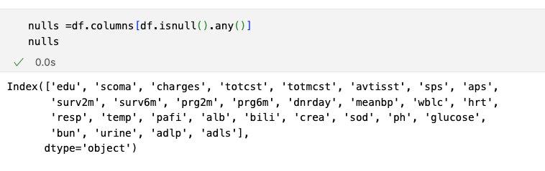
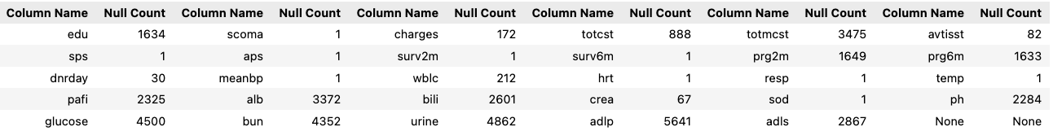
Data Preprocessing: Missing values
29 columns out of 47 had missing values (61%)
Depending on how many missing values has been in columns – they were either substituted for mean, empty rows were dropped or the whole column was dropped as feature.

Slide 8
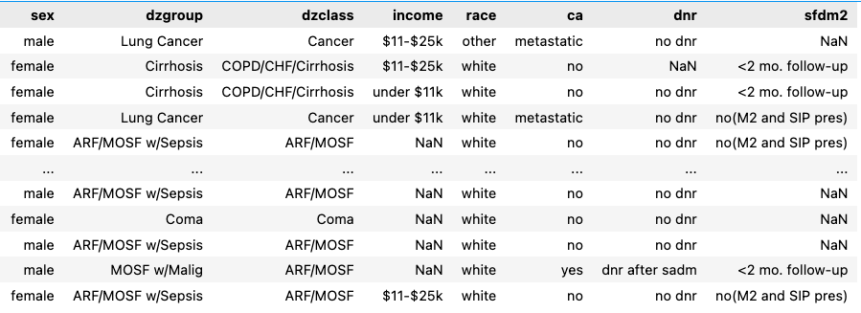
Data Preprocessing: Categorical values

Slide 9
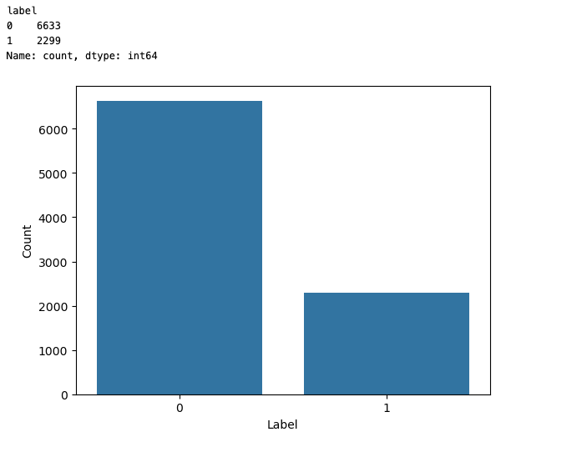
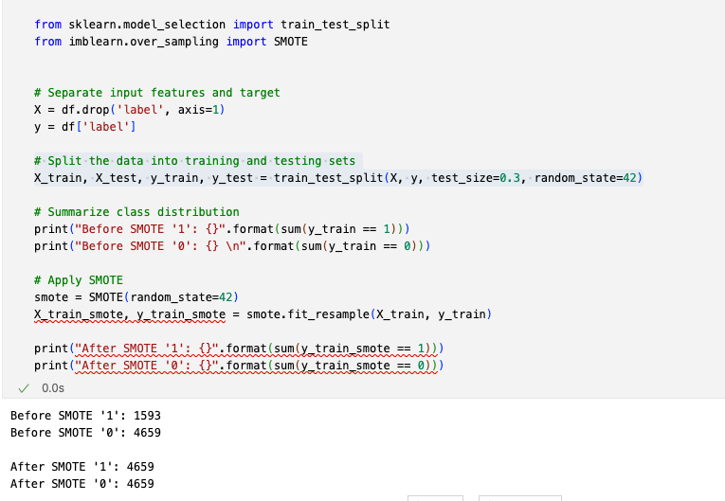
Data Preprocessing: Class Imbalance
The Synthetic Minority Oversampling Technique (SMOTE) is used to over-sample the minority class in a dataset and make the class distribution balanced. This technique generates synthetic samples rather than creating copies of existing samples.

Slide 10
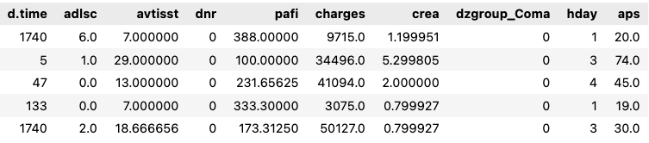
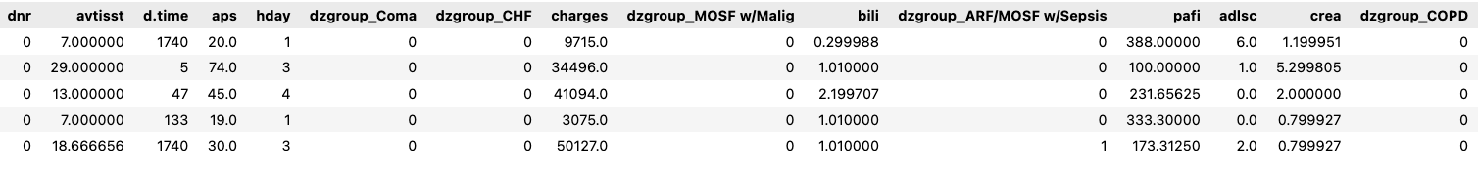
Classification Features
Set #1 Correlation & RT
Set #2 Correlation only
Notes:
description of features

Slide 11
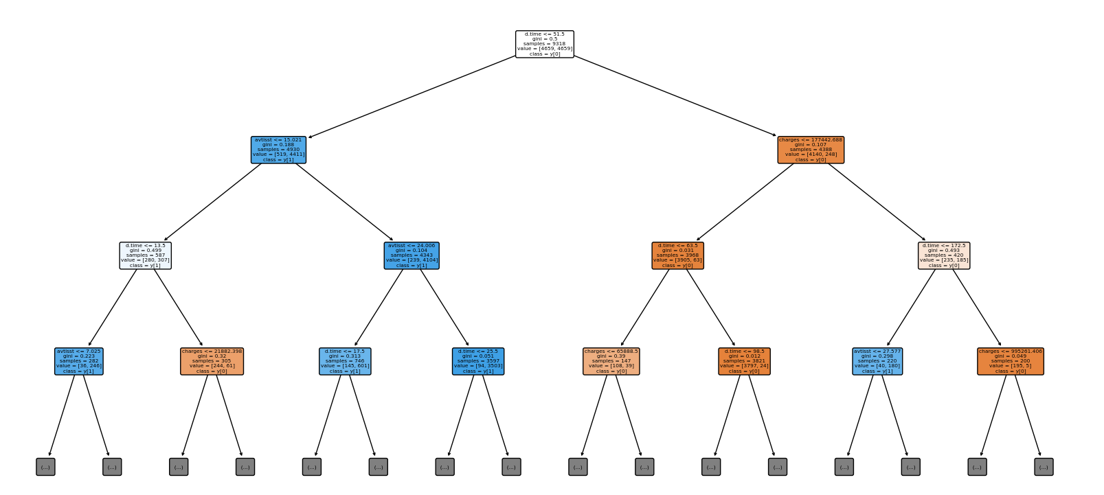
Decision Tree
Decision trees are highly interpretable models.
Decision trees can capture non-linear relationships between features and the target variable.
No assumptions about data distribution. This is beneficial when working with real-world medical data, which may not follow specific theoretical distributions.

Slide 12
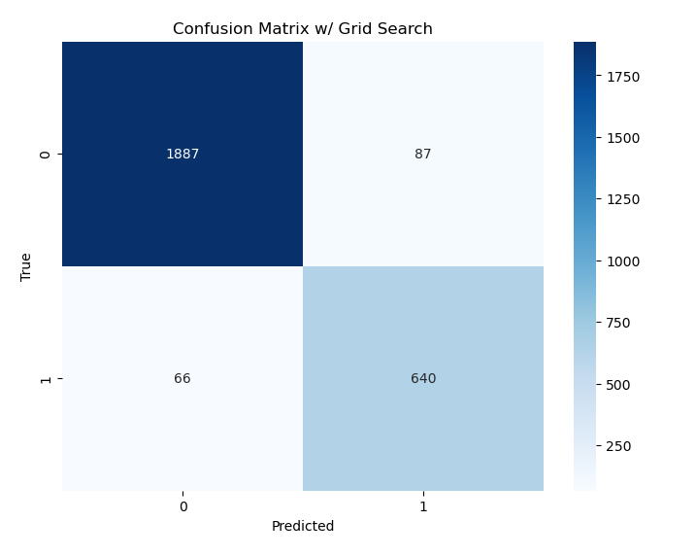
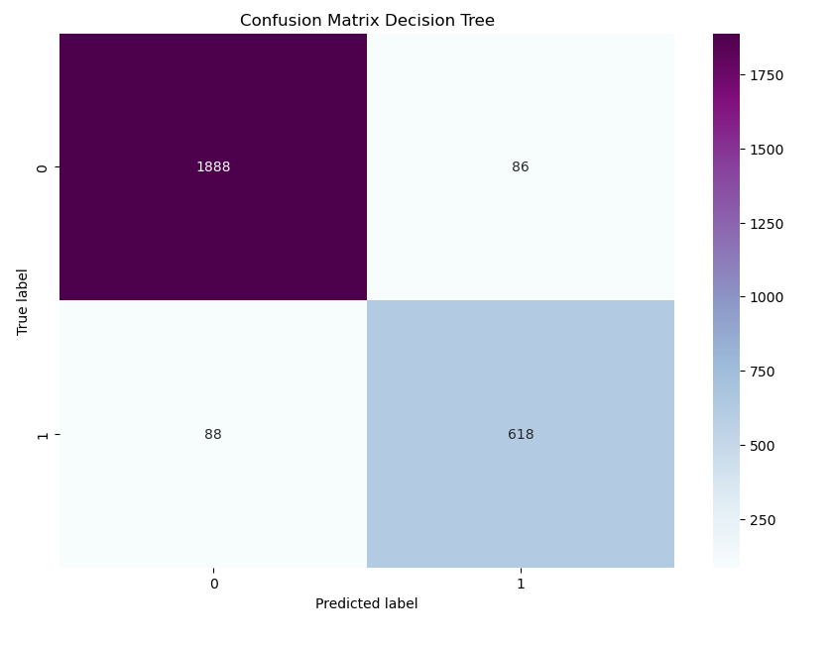
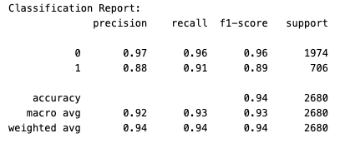
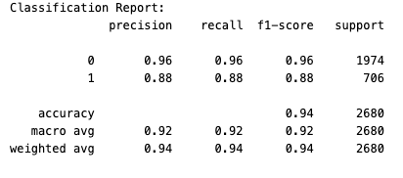
Decision Tree Results
In both models, the accuracy is similar at approximately 94%.
The precision, recall, and f1-score for predicting class '1' show improvement in the grid-search optimized model. Specifically, the recall for class '1' increased from 0.88 to 0.91, indicating that the optimized model is better at identifying true positive cases of this class.
The macro and weighted averages across precision, recall, and f1-score are slightly better in the grid-search optimized model, suggesting a more balanced performance across both classes.
Both models show a high number of true positives and true negatives. However, the grid-search optimized model has fewer false negatives (66 compared to 88) for class '1', which is critical in scenarios like predicting hospital deaths where missing a positive case can be more severe than a false alarm.

Slide 13
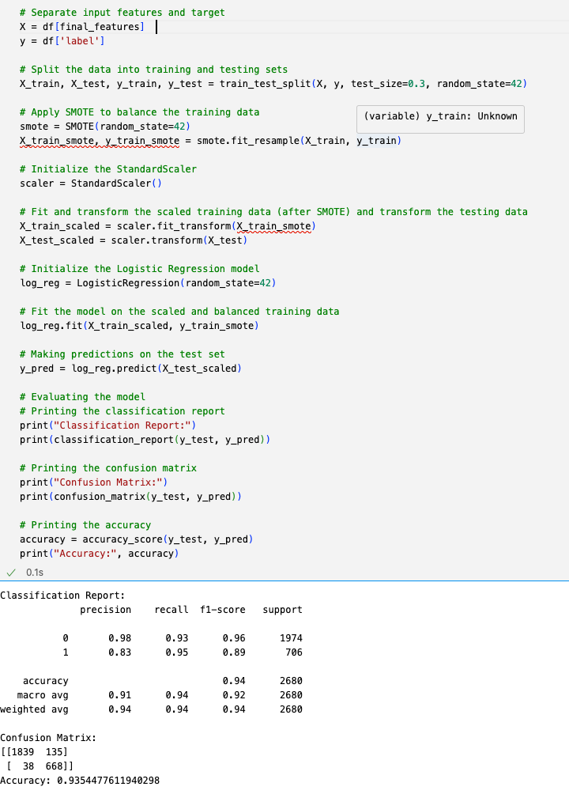
Logistic Regression
Great for binary classification
Logistic regression models offer good interpretability, allowing for an understanding of how each feature influences the likelihood of the outcome. This can be particularly valuable in a healthcare context, where understanding the risk factors associated with hospital mortality is crucial.
Dataset includes a wide range of features, both numerical (like 'age', 'scoma', 'charges') and binary/categorical (such as 'sex', 'diabetes'). Logistic regression can handle this mix of variable types effectively

Slide 14
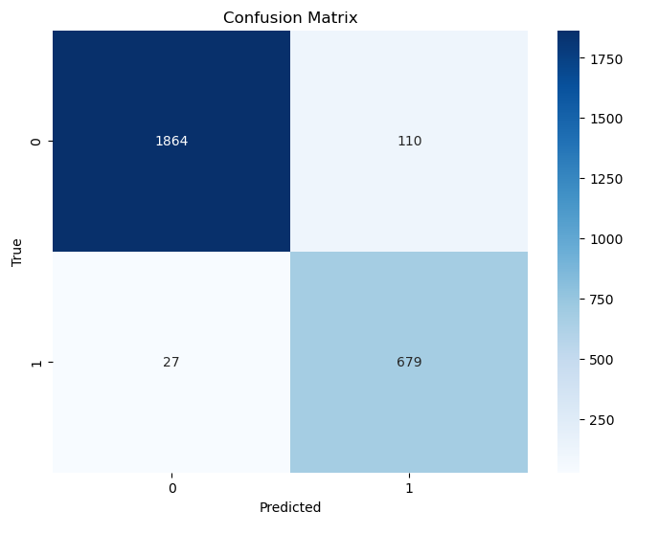
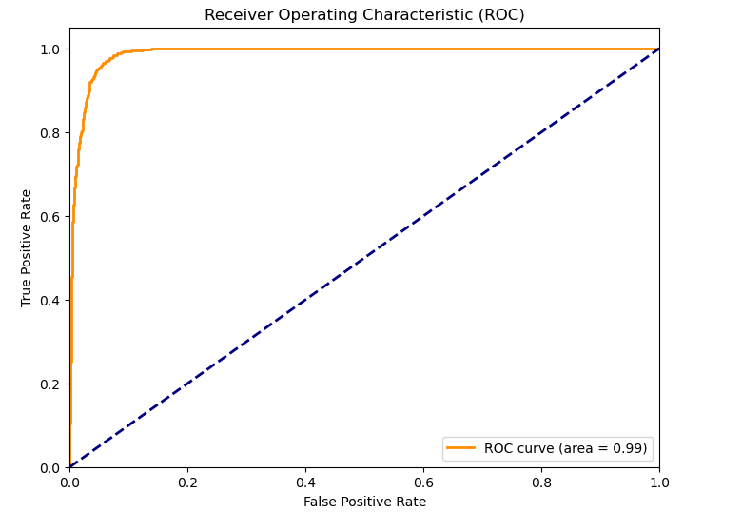
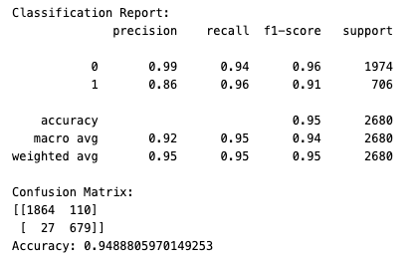
Logistic Regression Results
The optimized logistic regression model displays a high accuracy of 95% in predicting hospital mortality. It is exceptionally precise in identifying patients at low risk (precision: 99%), while also highly sensitive in detecting high-risk cases (recall: 96%). The balance between precision and recall is reflected in the strong F1-scores of 0.96 and 0.91 for the negative and positive classes, respectively. The model shows a tendency to predict mortality more conservatively, preferring to err on the side of caution with a slightly higher false positive rate. Overall, the ROC curve demonstrates an excellent AUC of 0.99, indicating superior discriminative ability. This model is highly effective for clinical decision-making, prioritizing the identification of patients at risk of hospital death.
Notes:
Confusion matrix: 1887 vs 679 right
110 vs 27 wrong

Slide 15
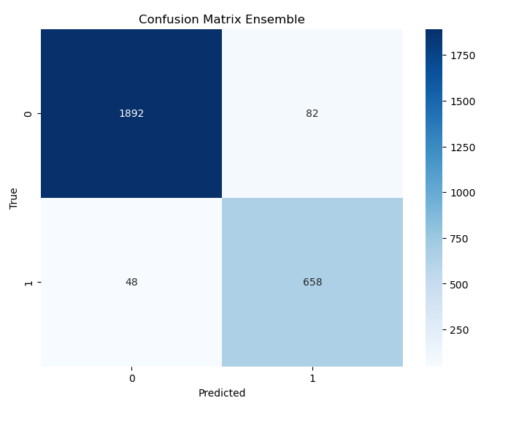
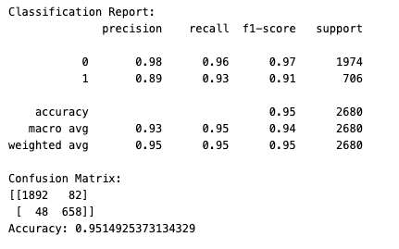
Ensemble model of DT, Logistic Regression and Random forest
An ensemble model harnesses the collective strength of multiple machine learning algorithms to improve predictive performance. By combining the decisions from distinct models—here, a Decision Tree, Logistic Regression, and Random Forest—the ensemble reduces the likelihood of errors that any single model might make. Our soft voting scheme, which considers the predicted probabilities from each model, ensures that the final prediction reflects a consensus with due weight to the confidence of each model's prediction.
The ensemble's efficacy is evident from its accuracy of 95.1%, showcasing its robustness in making correct predictions. The model achieves a commendable balance between precision and recall, affirming its capacity to accurately identify patients at risk while minimizing false alerts. The ROC curve, yielding an AUC of 0.95, substantiates the ensemble's excellent ability to differentiate between the patient outcomes. This confirms the ensemble's suitability for deployment in critical healthcare settings, providing a dependable tool for medical professionals to prioritize care and interventions.

Slide 16
Comparison of Classification models
In analyzing the performance metrics of the three predictive models, we observe that both the Logistic Regression with Grid Search and the Ensemble model exhibit superior accuracy and AUC scores, indicating their strong discriminative ability in predicting hospital mortality. The Logistic Regression stands out with the highest recall and AUC, suggesting it is particularly effective in identifying true positive cases without significantly increasing false positives. The Ensemble model, while closely matching the Logistic Regression in accuracy and F1-score, offers a balance between precision and recall.
The Logistic Regression with Grid Search emerges as the most robust model for this application, with its exceptional ability to identify patients at risk accurately. Its high recall is crucial in a medical context, ensuring that fewer cases at risk go unnoticed. The high AUC further reinforces its status as the best model, providing confidence in its use as a reliable tool for hospital mortality prediction.
Model | Precision | Recall | F1-Score | Accuracy | AUC
Decision Tree (Grid) | 0.88 | 0.91 | 0.89 | 0.94 | 0.93
Logistic Regression (Grid) | 0.86 | 0.96 | 0.91 | 0.95 | 0.99
Ensemble | 0.89 | 0.93 | 0.91 | 0.95 | 0.95
Notes:
Both Logistic Regression and the Ensemble model have a superior accuracy and AUC score
Logistic Regression stands out with highest recall and AUC suggesting that it is effective in identifying true positive cases without increasing false positives.
The logistic Regression with Grid Search is the best model forthis application since accurately identifies patients and has a high recall which is crucial in a medical context ensuring that fewer cases at risk go unnoticed

Slide 17
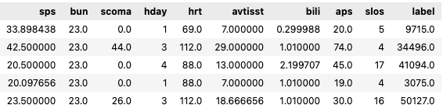
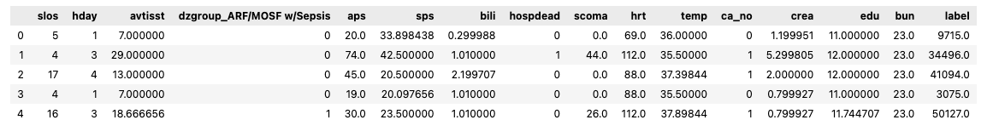
Regression Features
Set #1 Intersection between correlating features & random forest choice
Set # 2 Only correlation top features

Slide 18
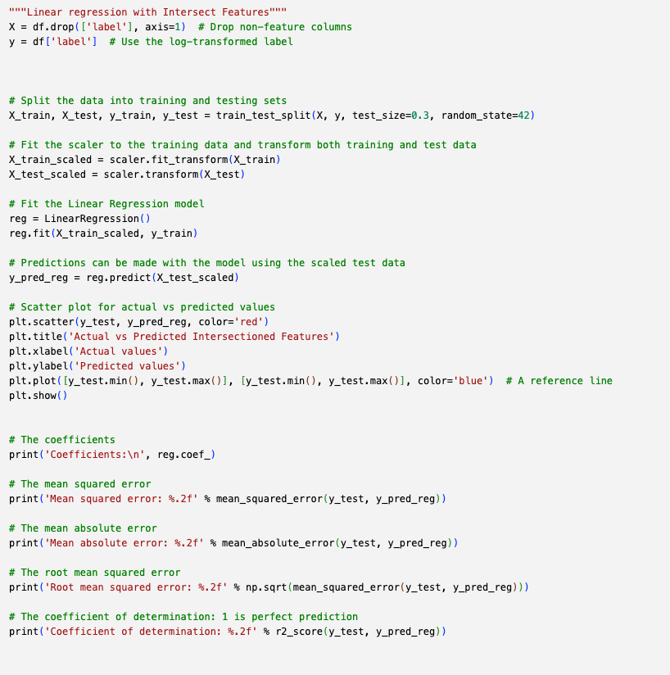
Linear Regression
Captures Linear Relationship: several features in the dataset, such as length of stay and severity of illness, likely have a linear relationship with medical charges, making linear regression a suitable model for capturing these relationships.
Linear regression provides clear interpretability, allowing healthcare professionals to understand how different factors, like age or medical procedures, are associated with the total charges, which is invaluable for cost analysis and management.
It is computationally efficient and straightforward to implement, making it an excellent starting point for modeling and understanding the underlying structure of the data before considering more complex models.
As charges are a continuous variable, linear regression is well-suited for making quantitative predictions, which can be directly used in financial planning and budgeting within the healthcare system.

Slide 19
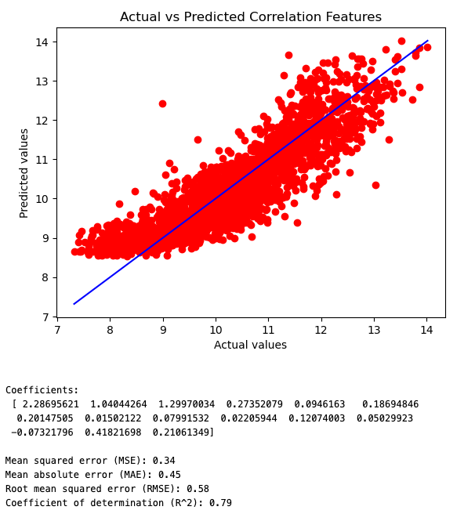
Linear Regression Results
variable, with a coefficient of determination (R²) of 0.79. This suggests that approximately 79% of the variability in the target can be explained by the model's inputs. The model's coefficients indicate the relative influence of each feature on the target variable, with the first feature having the most substantial positive impact on the prediction.
However, the mean squared error (MSE) and root mean squared error (RMSE) values are 0.34 and 0.58, respectively, which points to the average squared difference and the standard deviation of the prediction errors. The mean absolute error (MAE) of 0.45 reflects the average absolute difference between predicted values and actual values. These error metrics suggest that the model's predictions are reasonably close to the true values but could potentially be improved with further model tuning or feature selection.

Slide 20
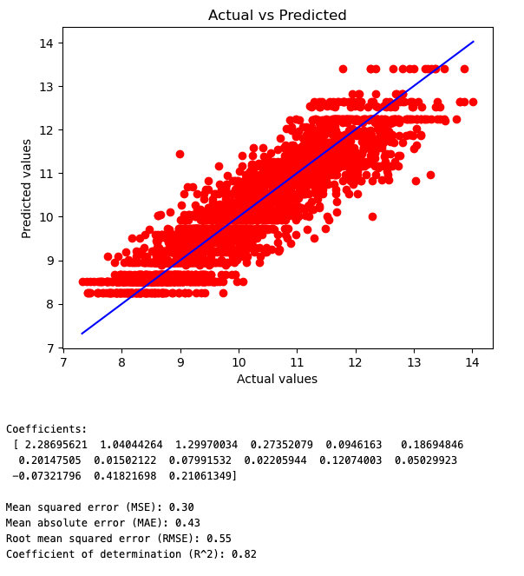
Regression Decision Tree Results
The Decision Tree Regressor exhibits promising results with a coefficient of determination (R²) of 0.82, indicating that it successfully captures 82% of the variance in the target variable.
The model's predictive accuracy is further evidenced by relatively low error metrics: a mean squared error (MSE) of 0.30 and a root mean squared error (RMSE) of 0.55, both of which imply that the model's predictions are fairly close to the actual values.
The mean absolute error (MAE) of 0.43 reinforces this, suggesting that, on average, the model's predictions deviate from the actual values by a moderate margin. These metrics collectively signify that the Decision Tree Regressor is a reliable and effective model for our data.
Notes:
succesfully caprutes 82% of the variance. Has relatively low error metrics: Mean Squared Error 0.3 and root mean squared error of 0.55 both of which implies that models predictions are fairly close to actual values.
The mean absolute error of 0.43 suggest that on average the model predictions deviate by moderate margin.

Slide 21
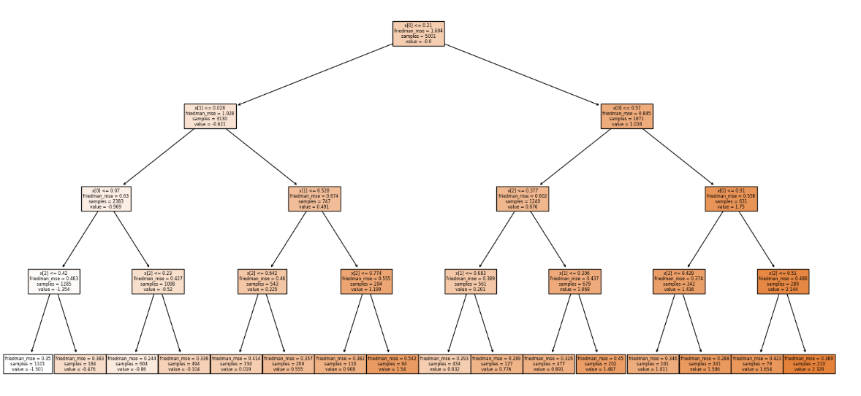
Gradient Boosting Regressor with parametrs from GridSearchCV
Gradient Boosting Regressor is well-suited for our dataset as it builds upon an ensemble of weak prediction models, typically decision trees, to iteratively correct errors made by prior models, leading to a more robust and accurate overall model. Its ability to handle complex, non-linear relationships in the data can capture deeper insights and improve predictions beyond what simpler models like linear regression can achieve. Furthermore, its flexibility with various hyperparameters, including tree characteristics and learning rate, allows for fine-tuning to closely fit our specific dataset, effectively reducing overfitting and enhancing prediction accuracy.

Slide 22
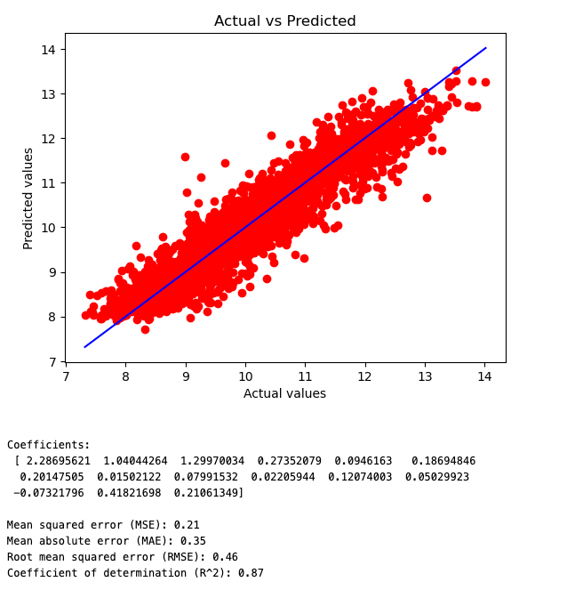
GDBR w/ Grid search cv results
The Mean Squared Error (MSE) is 0.21, suggesting that the model's predictions are generally close to the actual values, with a low average squared deviation.
The Root Mean Squared Error (RMSE) of 0.46 further indicates a good fit, as it represents the standard deviation of the residuals (prediction errors) and is relatively low.
The Mean Absolute Error (MAE) of 0.35 reinforces the model's accuracy, showing that, on average, the absolute difference between predicted and actual values is small.
An R² value of 0.87 is particularly noteworthy, implying that the model explains 87% of the variance in the target variable. This high value indicates a strong model that effectively captures the underlying patterns in the data.
The coefficients of the model, ranging from negative values to values above 2, reflect the varying degrees of influence each feature has on the target variable. Positive coefficients indicate a direct relationship, while negative coefficients indicate an inverse relationship.
In summary, the Gradient Boosting Regressor demonstrates robust performance with high predictive accuracy and a strong ability to explain the variability in your data. The low error values coupled with a high R² score indicate that this model is well-suited for predicting the target variable in your dataset.

Slide 23
Regression Model Comparison
Model | MSE | MAE | RMSE | R2
Linear Regression | 0.34 | 0.45 | 0.58 | 0.79
Decision Tree | 0.30 | 0.43 | 0.55 | 0.82
Gradient Boosting | 0.21 | 0.35 | 0.46 | 0.87
The Gradient Boosting model outperforms both the Linear Regression and Decision Tree models across all metrics, indicating it is the best model for this dataset. It has the lowest MSE, MAE, and RMSE, suggesting more accurate and consistent predictions. Additionally, its R² value is the highest, indicating the model explains a larger proportion of variance in the data. These results suggest that Gradient Boosting's complex ensemble approach is more effective for this particular dataset than the simpler linear and tree-based models.

Slide 24
Questions?

